Slide 1
Japanese Game

Slide 2
Grade: Kindergarten Class
Prior knowledge:
Students have learned directional phrases, greetings, calendar,
numbers, weather, and family members.
Objectives:
Students will learn parts of face in Japanese.
Students will connect a traditional Japanese New Year game with their own games that they play.

Slide 3

Parts of face
はな（hana)
まゆげ（mayuge）
め（me)
くち（kuchi）
ほっぺ（hoppe)

Slide 4
Fukuwarai (Lucky Laugh)
A: Covers eyes with blindfold.
B: Gives A one of the face parts saying the name such as hana (nose).
A: Listens to B and locates the right place to place the part.
Continue until all parts have been placed on the face.
A: Take off the blindfold to see the results.

Slide 5
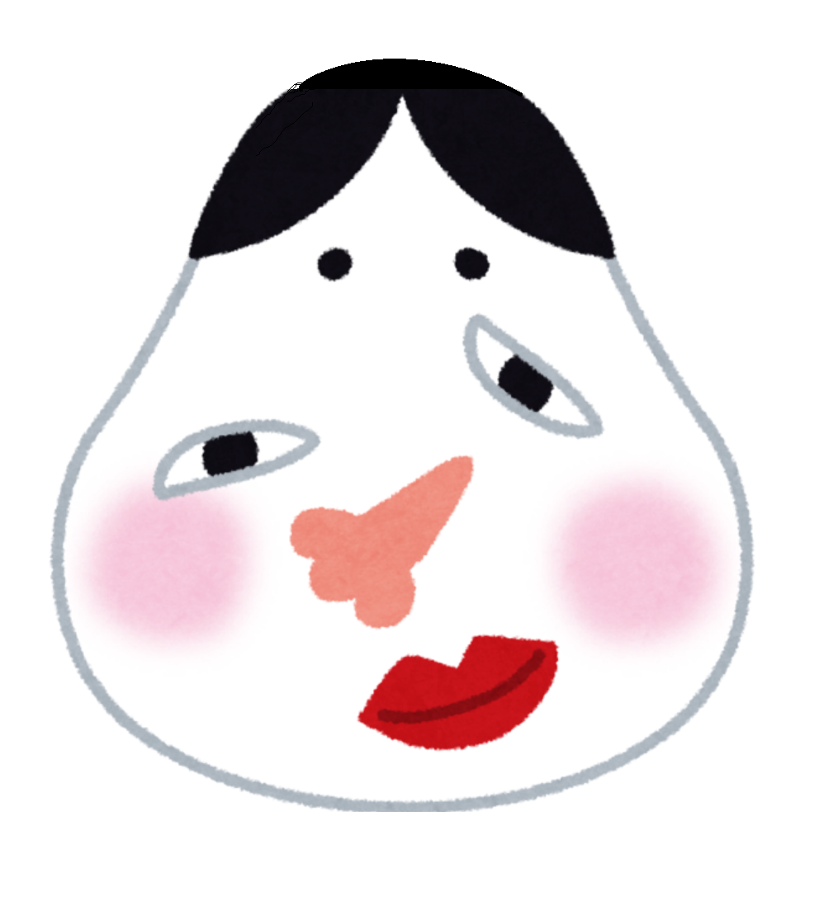
Fukuwarai (Lucky Laugh)
ふくわらい

Slide 6
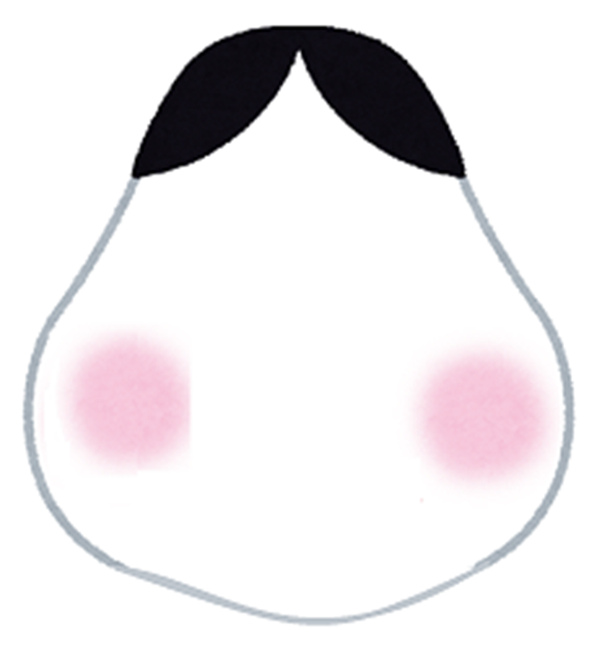







Slide 7
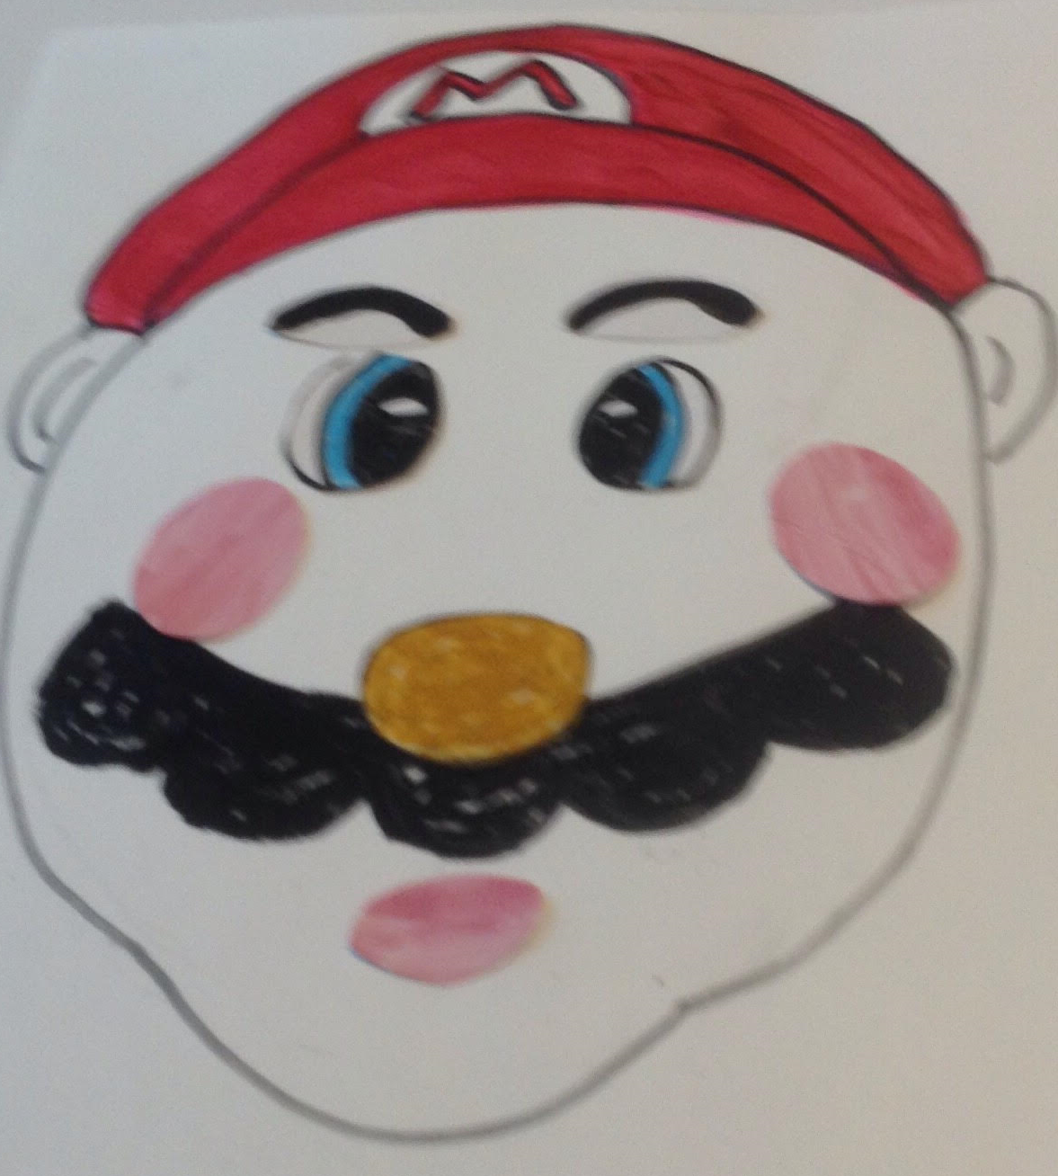
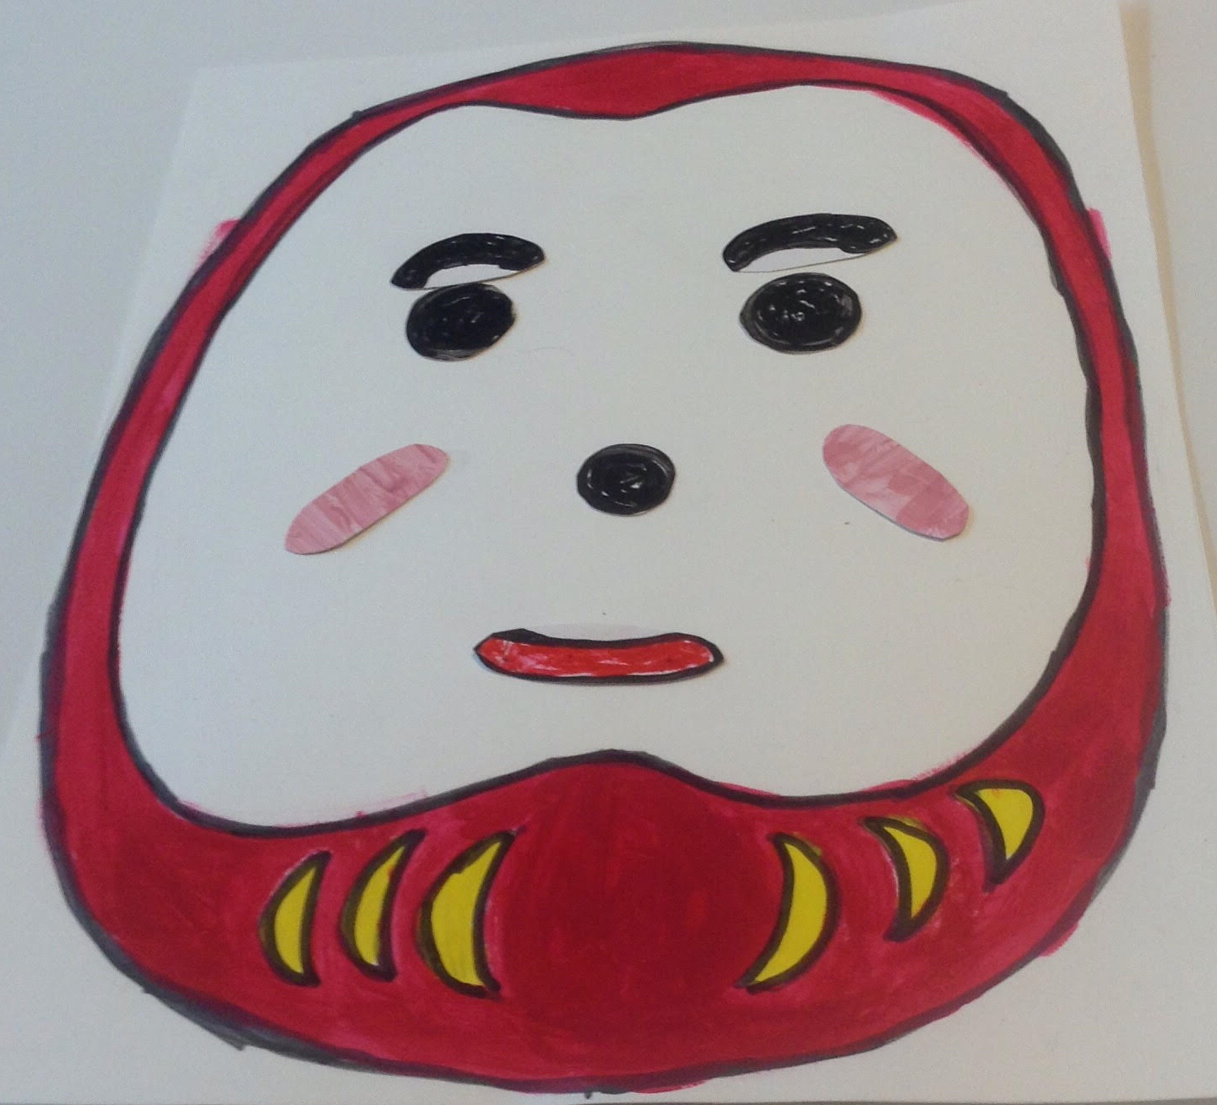
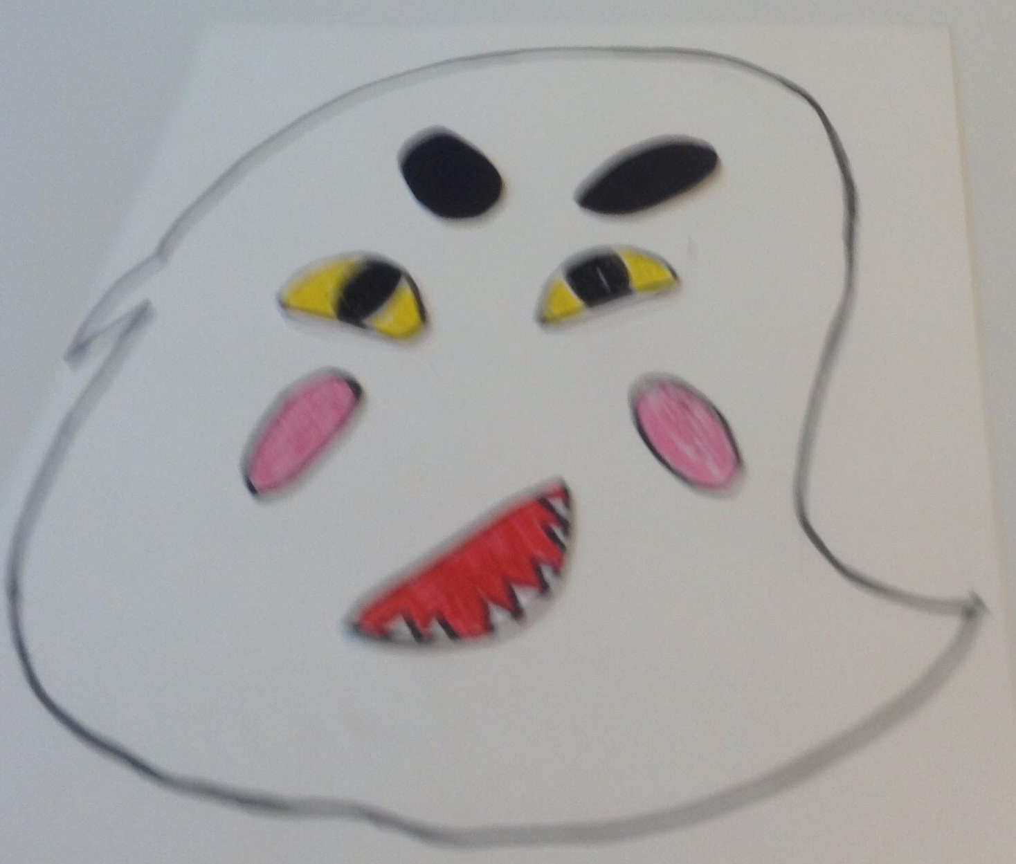
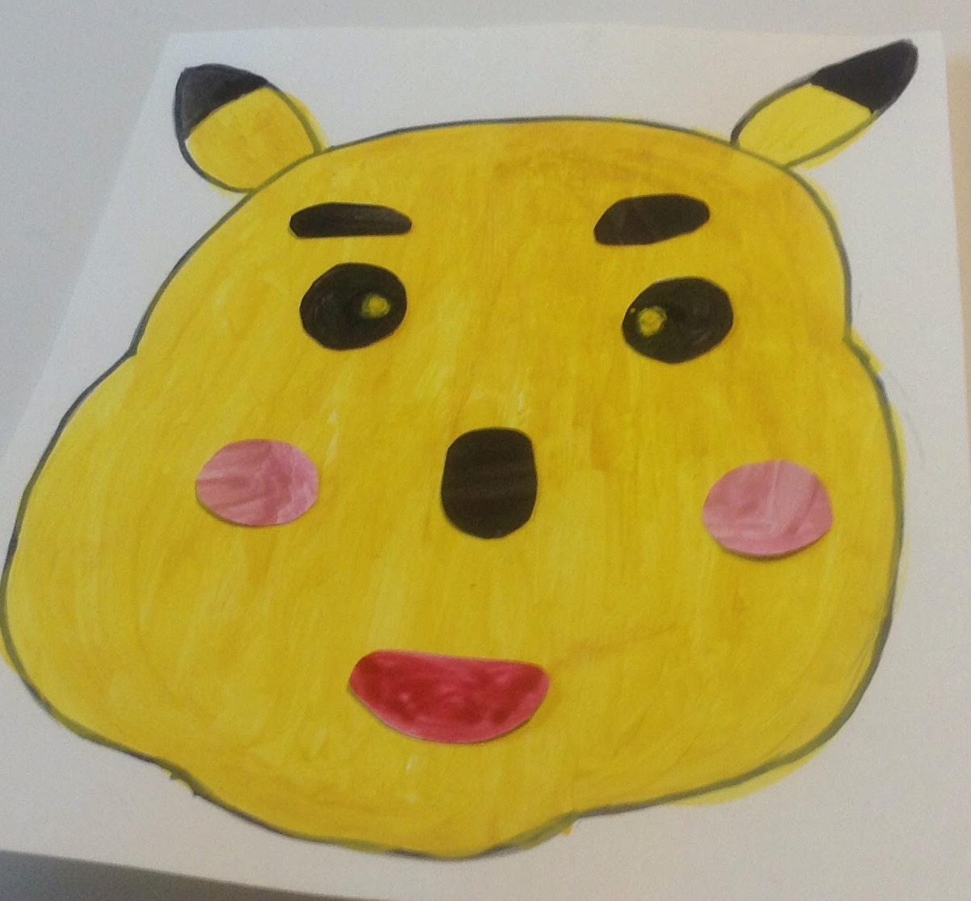
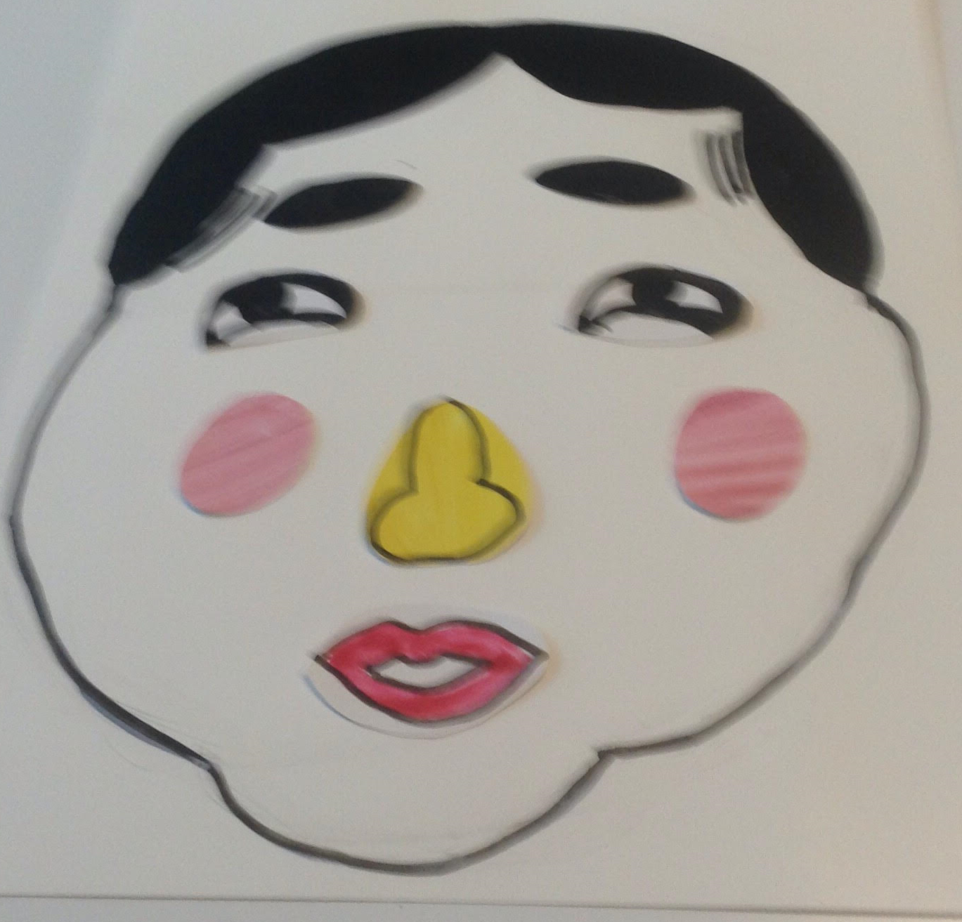
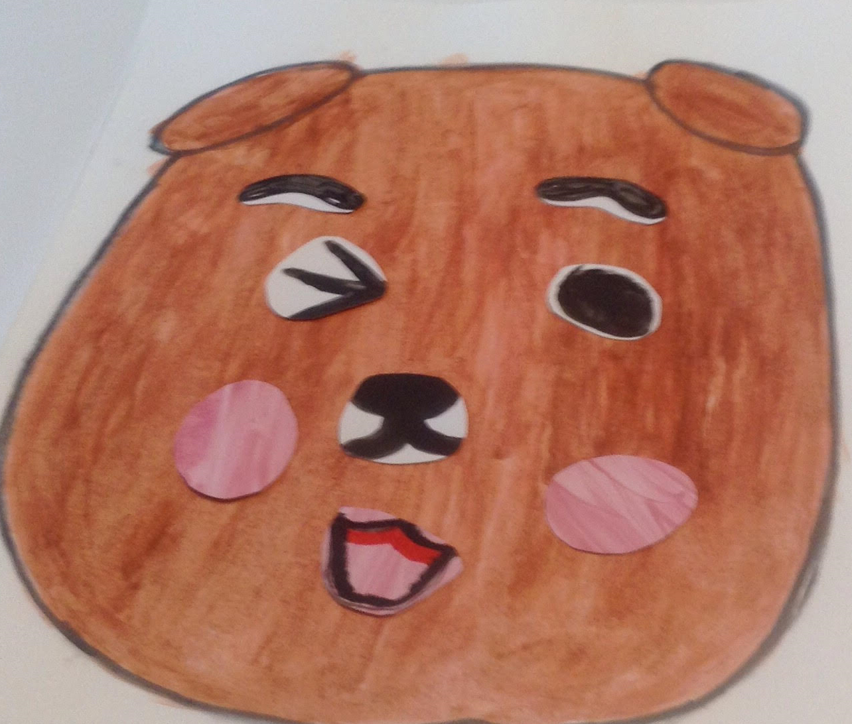
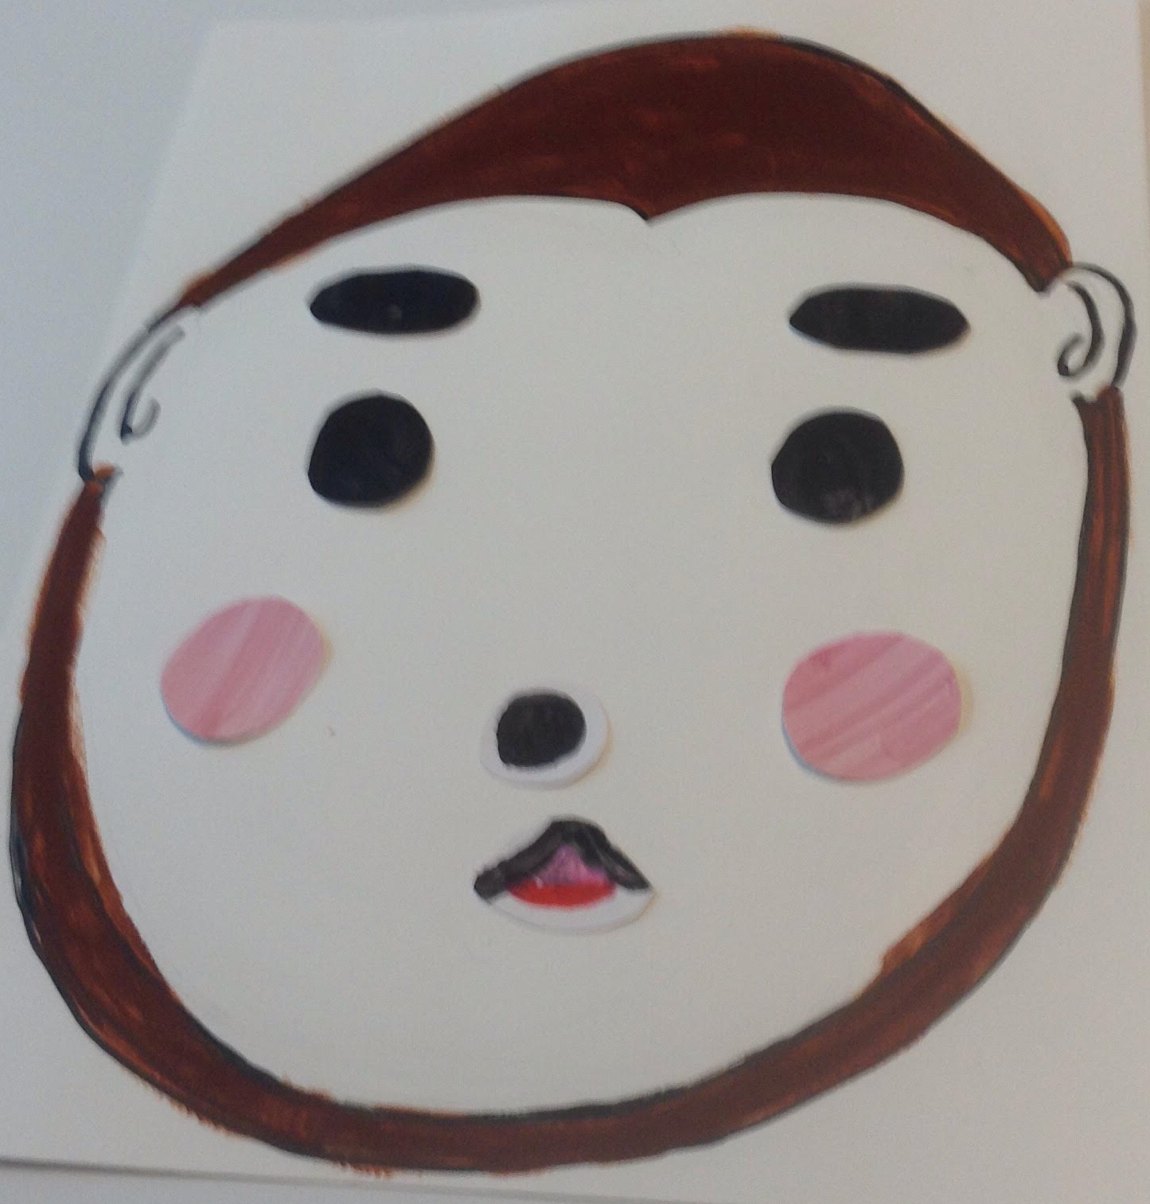
Let’s Play!

